Slide 1
Gen AI Project Proposal
Image Generation Using GANs
By Bradford Bush and Joseph Kelly
CSC 690
Notes:
"Good evening everyone. Today, I'm excited to present our proposal on 'Image Generation Using Generative Adversarial Networks (GANs).' This project explores how we can leverage advanced machine learning techniques to create realistic images autonomously."
Introduce yourself and briefly outline the agenda for the presentation

Slide 2
Project Roles
Bradford Bush - Team lead, head programmer, in charge of metrics display.
Joe Kelly - Head of dataset research, found an original GAN model to use against our model (NewGAN), helped with debugging and testing hyperparameters.

Slide 3
Project Objective
Goal:
Develop an advanced Generative Adversarial Network (GAN) capable of autonomously generating high-fidelity images.
Specific Tasks:
Implement a Deep Convolutional GAN (DCGAN) using Tensorflow.
Train the model on a comprehensive dataset of images.
Evaluate the quality and authenticity of generated images using qualitative and quantitative metrics.
Notes:
"Our primary goal is to develop a sophisticated Generative Adversarial Network capable of autonomously generating high-fidelity images."
We want to attempt to “trick” the program into having the highest degree of realism.
"To achieve this, we'll implement a specialized form of GAN known as Deep Convolutional GAN (DCGAN) using Tensorflow for the GAN model.
"Our focus will be on training the model on a diverse dataset of images and evaluating the quality of the generated outputs using both qualitative and quantitative metrics."

Slide 4
Introduction to GANs
What are GANs?
Generative Adversarial Networks (GANs) are a class of machine learning frameworks comprising two neural networks: the Generator and the Discriminator.
Generator: Creates synthetic data (images) from random noise.
Discriminator: Evaluates the authenticity of images, distinguishing between real and generated ones.
GANs operate through adversarial training, where the Generator aims to fool the Discriminator into mistaking its generated images for real ones.
Notes:
"Let's start with an introduction to Generative Adversarial Networks, or GANs. These are a powerful class of AI models consisting of two main components: the Generator and the Discriminator."
"The Generator creates new images from scratch using random noise, while the Discriminator evaluates these images to determine if they are real or generated."
"GANs work by pitting these two networks against each other in a game-like scenario, where the Generator learns to produce increasingly realistic images to fool the Discriminator."

Slide 5
How GANs Work
Training Process:
Step 1: Generator Creation
Begins with random noise input, generates an image resembling real data.
Step 2: Discriminator Evaluation
Discriminator assesses both real and generated images, refining its ability to differentiate between them.
Step 3: Feedback Loop
Generator adjusts based on Discriminator feedback to create more authentic images, while Discriminator improves its discrimination capabilities.
Over iterations, this adversarial process leads to the generation of high-quality, realistic images.
Notes:
"Now, let's delve into how GANs operate."
"During training, the Generator starts with random noise as input and attempts to generate images that resemble real data."
"Simultaneously, the Discriminator evaluates these generated images alongside real images from our dataset, learning to distinguish between them."
"Through this iterative process, both networks improve: the Generator becomes adept at creating more convincing images, while the Discriminator enhances its ability to discern real from fake."

Slide 6
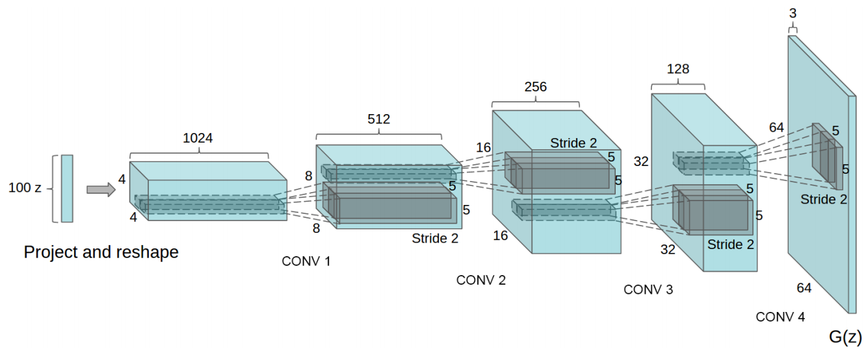
DCGAN in Tensorflow
Tensorflow implementation of Deep Convolutional Generative Adversarial Networks which is a stabilize Generative Adversarial Networks. The referenced torch code can be found here.
Notes:
Input Dimension:
"Starts with a 100-dimensional uniform distribution, Z."
Projection:
"Z is projected into a small spatial extent convolutional representation with many feature maps."
Fractionally-Strided Convolutions:
"A series of four fractionally-strided convolutions transform this representation into a 64×64 pixel image."
"These are sometimes incorrectly referred to as deconvolutions in recent papers."
Layer Usage:
"Notably, the architecture avoids fully connected and pooling layers entirely."

Slide 7
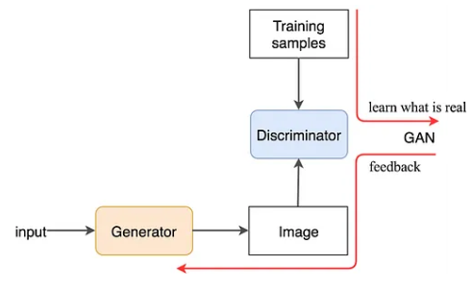
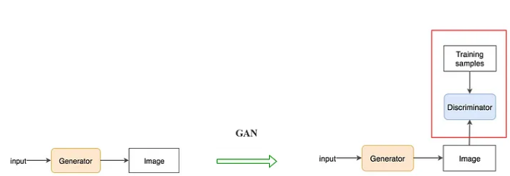
Visual Representation of GAN Model Logic
Notes:
Training Process:
GANs use real and generated images to train the discriminator.
The discriminator learns to identify features of real images.
Discriminator Function:
Separately processes real and generated images.
Outputs the probability that an input image is real (D(X)).
Aims for D(x) = 1 for real images, D(x) = 0 for generated images.
Identifies key features of real images through this training.
Generator Function:
Aims to produce images that make D(x) = 1.
Uses feedback from the discriminator to improve image realism.
Trained through backpropagation to mimic real images closely.
Overall Goal:
Discriminator provides feedback to help the generator create realistic images.
Both networks improve through this adversarial process.

Slide 8
Dataset Description
Dataset Used:
CelebA Dataset with over 200k images of celebrities with 40 binary attribute annotations (changed from the CIFAR-10 dataset).
Dataset Characteristics:
Images are 32x32 pixels in size, offering a diverse and challenging dataset for training image generation models.
Notes:
"These images are relatively small, 32x32 pixels in size, yet they offer a rich diversity of objects and scenes."
"By training our model on this dataset, we aim to replicate the complexity and variability found in real-world images."

Slide 9
Image Generation Process
How It Works:
Utilizes a vector z with 100 real numbers (0 to 1).
Generates images based on values in z.
Training involves adjusting z to improve image realism.
Notes:
"Let's explore the mechanics of Generative Adversarial Networks (GANs) and how they generate images."
"At the core of a GAN is a vector z, typically consisting of 100 real numbers ranging between 0 and 1."
"This vector z acts as the seed for the Generator, which interprets these values to produce images."
"During the training process, the Generator fine-tunes the values within z to enhance the realism of the generated images."
"By adjusting these values, the Generator learns to synthesize images that closely resemble the patterns and characteristics present in the training dataset."
"Through iterative adjustments via techniques like backpropagation, the Generator refines z to progressively improve the quality and fidelity of the images it creates."

Slide 10
Model Architecture
Generator Architecture:
Input: Random noise vector (e.g., 100 dimensions).
Layers: Fully connected layers, up-sampling layers (transposed convolutions), batch normalization, and output layer with tanh activation.
Discriminator Architecture:
Input: Image (e.g., 32x32 pixels).
Layers: Convolutional layers, Leaky ReLU activation, dropout layers, and output layer with sigmoid activation.
Notes:
"Let's discuss the architecture of our GAN model."
"The Generator starts with a random noise vector and uses a series of fully connected and up-sampling layers to produce images."
"On the other hand, the Discriminator employs convolutional layers and activation functions like Leaky ReLU to evaluate the authenticity of these generated images."
"These architectural choices are crucial in ensuring our model can effectively learn and reproduce realistic images."

Slide 11
Training the GAN
Training Process:
Alternating updates between the Generator and Discriminator networks.
Discriminator Training:
Train on real and generated images, minimizing loss function.
Generator Training:
Train to deceive the Discriminator, maximizing adversarial loss.
Stabilization Techniques:
Implement label smoothing and gradient clipping to enhance training stability.
Notes:
"Training our GAN involves a dynamic interplay between the Generator and the Discriminator."
"The Discriminator learns to distinguish between real and generated images, while the Generator adjusts its strategy to produce images that are increasingly difficult for the Discriminator to differentiate."
"To stabilize training, we've implemented techniques like label smoothing and gradient clipping, which help mitigate common challenges such as mode collapse and vanishing gradients."

Slide 12
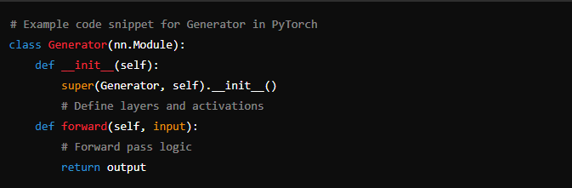
Implementation Details
Framework Used:
Colab
Tensorflow
NumPy
PIL for images
Tensorboard for metrics
Hyperparameters:
Learning Rate: 0.0002
Batch Size: 32
Epochs: 50 - 100
Optimizer: Adam
Notes:
Hyperparameters:
Batch Size: Number of images processed together in one forward/backward pass (32 in our case).
Noise Dimension: Size of the random noise vector input to the generator (100 dimensions).
Learning Rate: Controls the speed of the learning process (1e-4 for both generator and discriminator).
Epochs: Total number of complete passes through the training dataset (set to 50).
TensorBoard:
Purpose: A visualization tool provided by TensorFlow.
Usage:
Monitors training progress.
Visualizes metrics like generator and discriminator loss over epochs.
Helps in tuning hyperparameters by showing the impact of changes on model performance.
Features:
Real-time tracking of training metrics.
Graphs for loss and accuracy.
Visual inspection of generated images at different training stages.
Debugging tool to ensure the model is learning as expected.

Slide 13
Original Model Implementation
Original model comes from Kaggle example.
Dataset: CelebA Dataset
Hyperparameters:
Number of Images Used: 10,000
Batch Size: 32
Noise Dimension: 100
Epochs: 150
Generator Optimizer (Adam learning rate): 1e-4
Discriminator Optimizer (Adam learning rate): 1e-4
Dropout Rate: 0.3
LANCZOS Image Resampling method.
Notes:
This is the original model used from the Kaggle dataset we ended up with (CelebA dataset)
The CelebA dataset contains over 200,000 celebrity images with 40 attribute labels.
It is widely used for facial attribute recognition and image generation tasks.
Adam Optimizers for Generator/Discriminator:
What is Adam? Adaptive Moment Estimation (Adam) is an optimization algorithm used for training deep learning models.
Advantages:
Combines the best properties of the AdaGrad and RMSProp algorithms.
Maintains an adaptive learning rate for each parameter.
Uses running averages of both the gradients and their second moments (squares of the gradients).
Application in GAN:
Both the generator and discriminator use Adam optimizers with a learning rate of 1e-4.
Helps in achieving faster convergence and better performance in GAN training.
LANCZOS Image Resampling Method:
Purpose: A method for resizing images with minimal loss of quality.
Technique:
Applies a high-quality filter that considers multiple surrounding pixels to calculate the new pixel value.
Particularly effective for reducing aliasing and preserving details.
Usage in this Project:
Used to resize images to 64x64 pixels.
Ensures the resized images retain maximum details and quality, crucial for generating realistic images.

Slide 14
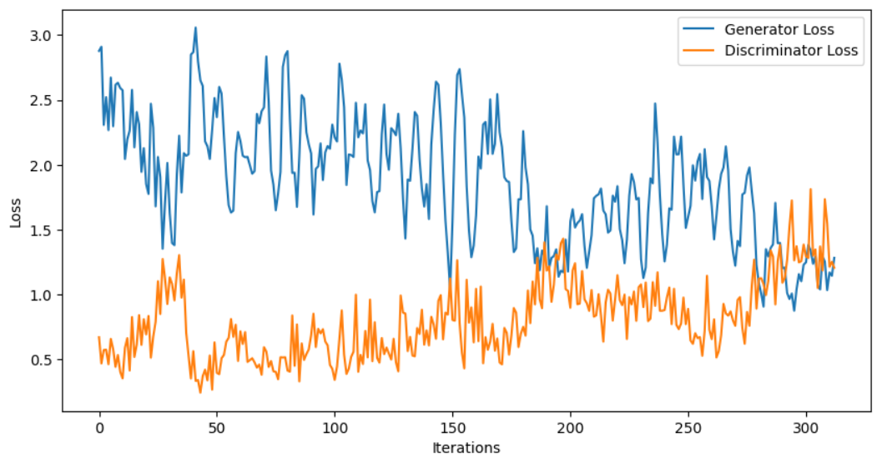
Training Metrics - Loss Results After 1 Epoch
Notes:
The point of showing our metrics just after only 1 epoch is to show the disparity from other metrics.

Slide 15
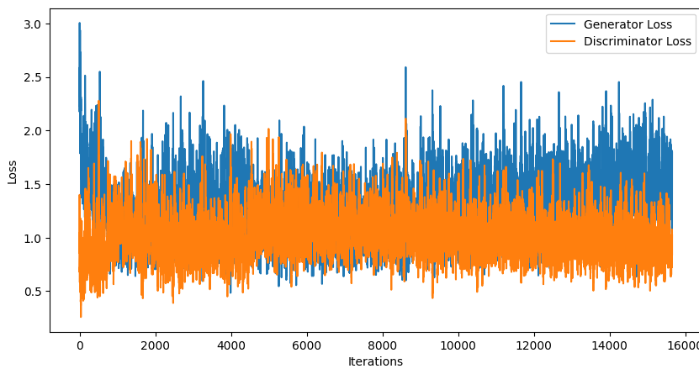
Training Metrics - Loss After 100 Epochs
Notes:
As you can see the loss rate is slightly improved Oscillation in GAN Training:
Definition:
Oscillation refers to the phenomenon where the GAN's generator and discriminator repeatedly change in performance, without converging to a stable state.
Why it Happens:
Competitive Nature: GANs involve a two-player game where the generator tries to create realistic images, and the discriminator tries to distinguish between real and generated images.
Dynamic Objectives: As the generator improves, the discriminator's task becomes harder, and vice versa. This constant improvement and adaptation can lead to instability.
Non-convex Optimization: The loss landscapes for both the generator and discriminator are complex and non-convex, making it difficult for optimization algorithms to find a stable equilibrium.
Effects of Oscillation:
Training Instability: Oscillations can make it difficult to achieve stable and consistent improvements.
Model Performance: May result in the generator producing lower-quality images intermittently, even after showing initial improvements.

Slide 16
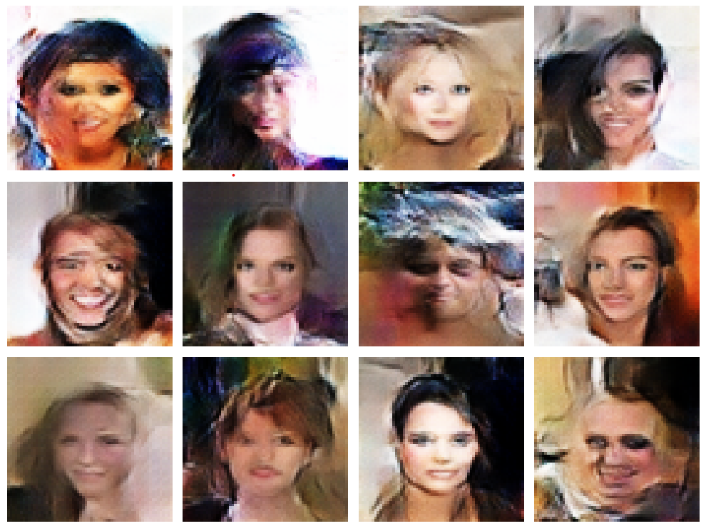
Image Output Generated After 150 Epochs
Notes:
Final output of the first model, as you can see, image generation needs a lot of data to work with in order to optimize, and with limited resources on Colab these didn’t come out GREAT, but they are generated from noise.

Slide 17
Image Generation Using New Model
New GAN model
Hyperparameters:
Number of Images Used: 7,500
Batch Size: 32
Noise Dimension: 100
Epochs: 50
Generator Optimizer (Adam learning rate): 1e-4
Discriminator Optimizer (Adam learning rate): 1e-4
Dropout Rate: 0.3
LANCZOS Image Resampling method.

Slide 18
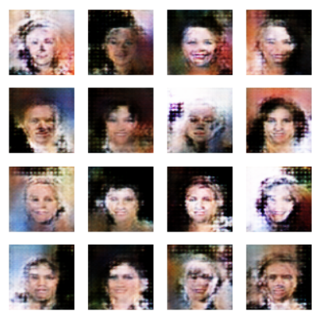
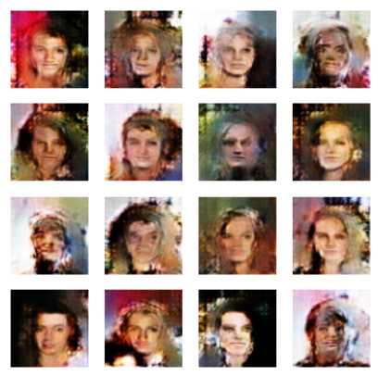
Training - Epoch 25 (left) - Epoch 50 (right)

Slide 19
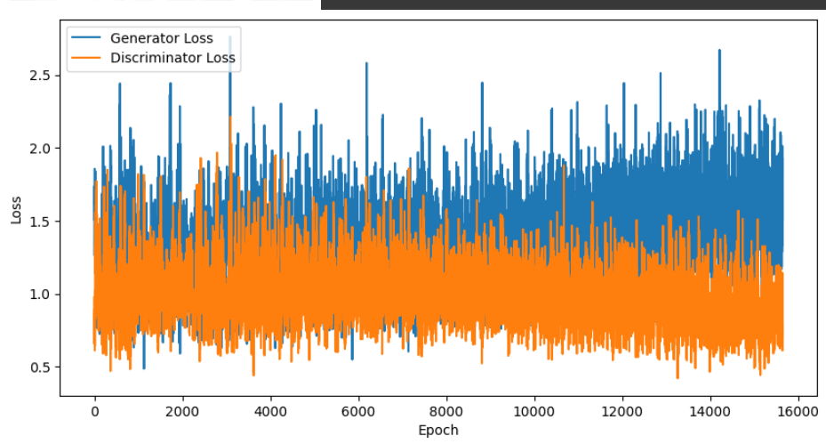
Training Metrics - Loss After 50 Epochs

Slide 20
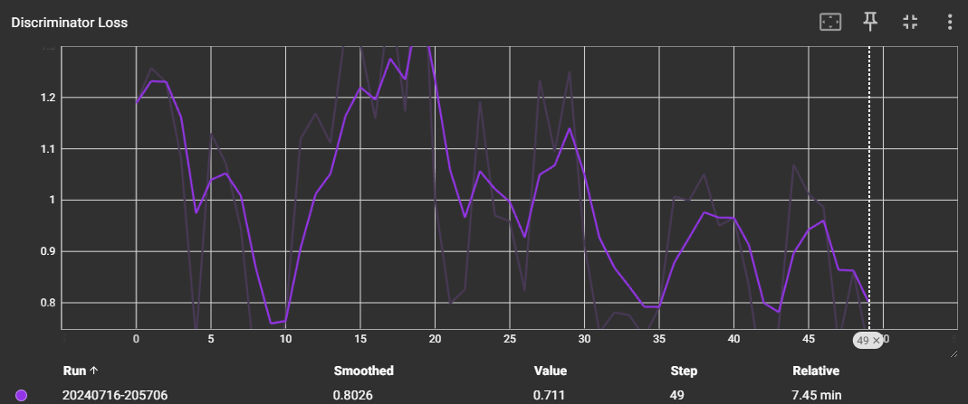
Training Metrics Using Tensorboard (Discriminator)

Slide 21
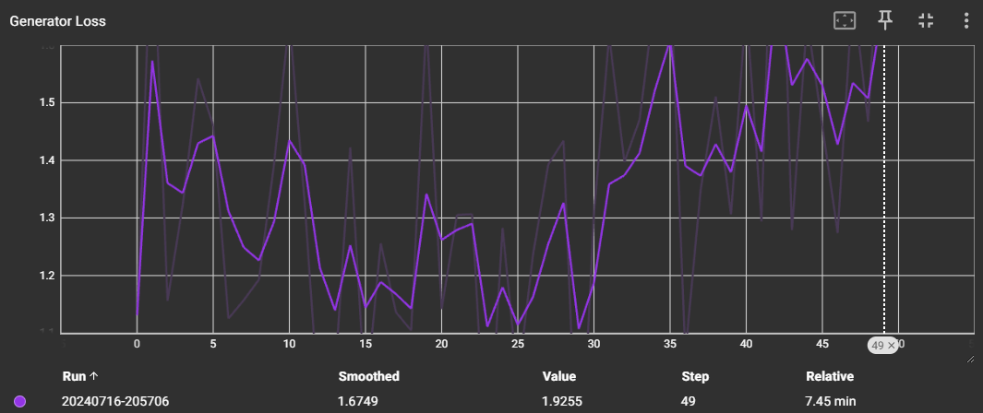
Training Metrics Using Tensorboard (Generator)

Slide 22
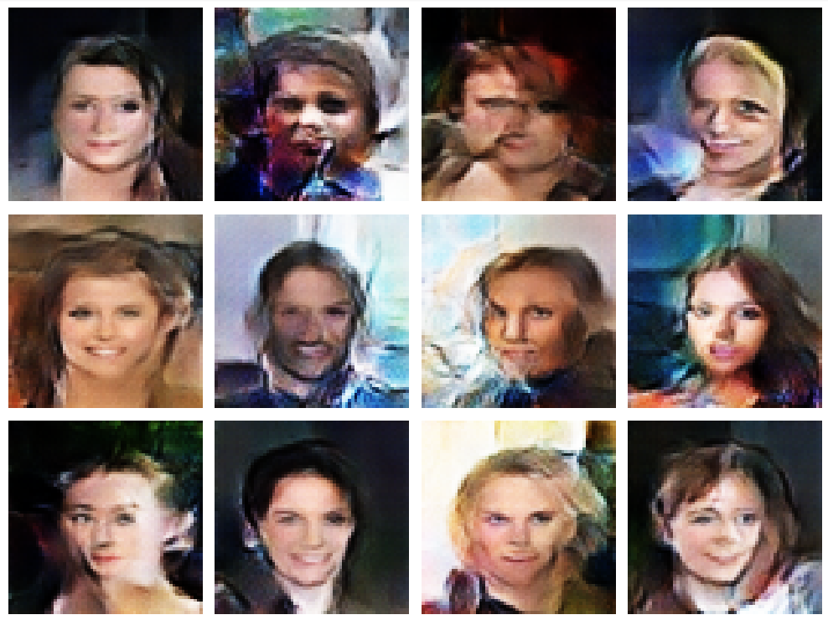
Image Output Generated After 50 Epochs

Slide 23
Image Generation Using New Model With Adjusting Parameters
New GAN model
Hyperparameters:
Number of Images Used: 10,000 (Increased number of images to train)
Batch Size: 32
Noise Dimension: 100
Epochs: 100 (Doubled the number of epochs)
Generator Optimizer (Adam learning rate): 1e-4
Discriminator Optimizer (Adam learning rate): 1e-4
Dropout Rate: 0.3
LANCZOS Image Resampling method.

Slide 24
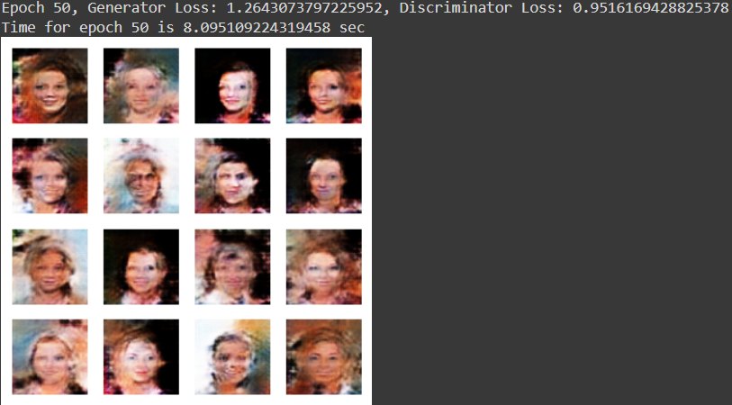
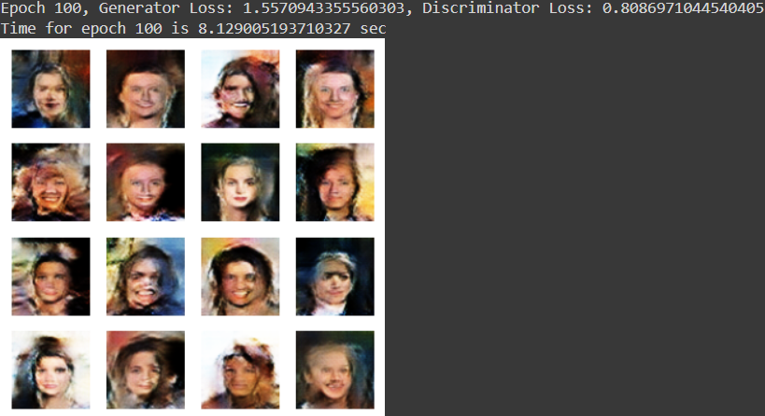
Training - Epoch 50 (left) - Epoch 100 (right)

Slide 25
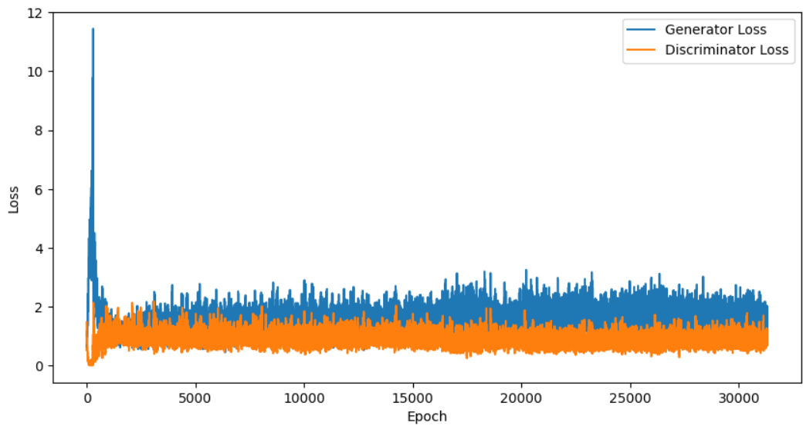
Training Metrics - Loss After 100 Epochs

Slide 26
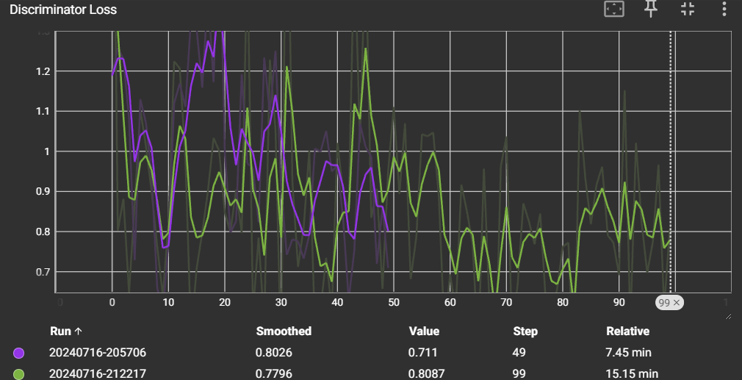
Training Metrics Using Tensorboard (Discriminator)

Slide 27
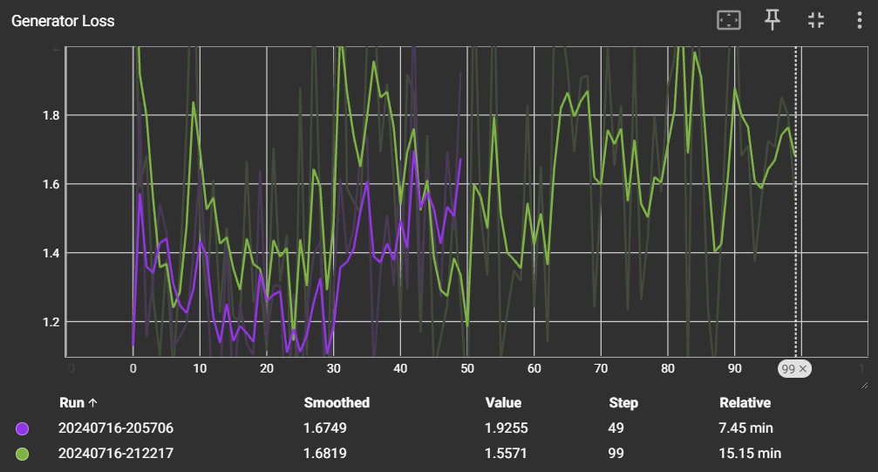
Training Metrics Using Tensorboard (Generator)

Slide 28
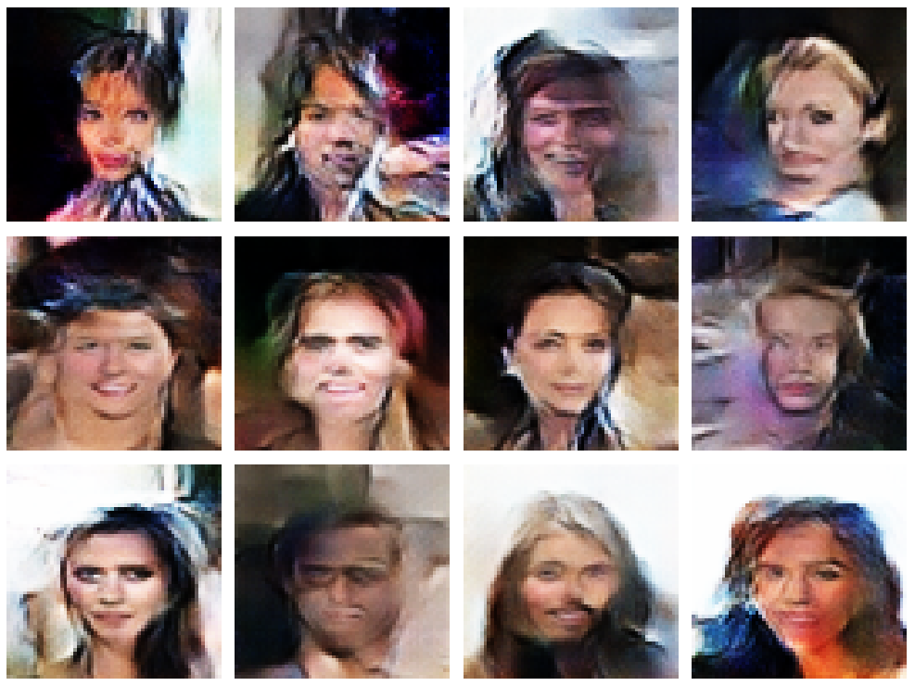
Image Output Generated After 100 Epochs

Slide 29
Challenges
Common Issues:
Mode collapse, vanishing gradients, and training instability.
Solutions Implemented:
Techniques like minibatch discrimination, number of images reduced/increased, tweaking the hyperparameters for best result.
Notes:
Common Issues:
Mode Collapse:
Occurs when the generator collapses to producing limited varieties of outputs, ignoring the diversity in the dataset.
Results in repetitive or non-diverse generated images.
Vanishing Gradients:
Occurs when gradients become too small during backpropagation, hindering effective learning.
Leads to slow or ineffective training progress, especially for deep networks.
Training Instability:
Manifests as erratic changes in loss values or poor convergence of the generator and discriminator.
Impedes the GAN from reaching an equilibrium where both networks improve simultaneously.
Solutions Implemented:
Minibatch Discrimination:
Introduces additional features to the discriminator to encourage diversity in generated samples.
Helps mitigate mode collapse by enforcing discrimination across batches rather than individual samples.
Adjusting Dataset Size:
Increasing or reducing the number of training images to balance diversity and model complexity.
Affects the diversity of generated outputs and the overall learning dynamics of the GAN.
Hyperparameter Tuning:
Tweaking learning rates, batch sizes, or network architectures to optimize GAN performance.
Critical for stabilizing training and improving the quality of generated outputs.
Significance:
Improving Stability:
Addressing these issues enhances the stability and effectiveness of GAN training.
Promotes diverse and high-quality outputs from the generator.
Iterative Process:
Requires iterative adjustments and experimentation to find the optimal settings for each specific application.
Balances the trade-offs between computational resources, training time, and output quality.

Slide 30
Evaluation
Qualitative Assessment:
Visual inspection of generated images for realism and diversity.
Quantitative Metrics:
Loss from both the discriminator and the generator.
Discussion:
Analysis of strengths (e.g., image fidelity) and weaknesses (e.g., artifacts) based on evaluation metrics.
Notes:
"Evaluation is critical to assessing the performance of our GAN model."
"We'll conduct both qualitative and quantitative assessments."
"Qualitatively, we'll visually inspect the generated images for realism and diversity."
Quantitative Metrics:
Loss Metrics:
Discriminator Loss:
Measures how well the discriminator can distinguish between real and generated images.
Calculated using the cross-entropy loss between the predicted labels and the actual labels (real or fake).
Lower loss indicates the discriminator is good at identifying real vs. fake images.
Generator Loss:
Measures how well the generator can produce realistic images that fool the discriminator.
Calculated using the cross-entropy loss between the discriminator's output for generated images and the label indicating real images.
Lower loss indicates the generator is improving and creating more realistic images.
Significance:
Monitoring Training: Both losses are monitored during training to assess the performance and stability of the GAN.
Balancing Act: Ideally, the losses should converge and balance out, indicating that both the generator and discriminator are learning and improving.
Training Progress: Helps in diagnosing issues such as mode collapse or training instability, guiding necessary adjustments in hyperparameters or training strategy.

Slide 31
Conclusions From Adjusting Parameters
The original model seemed to perform better than our GAN model initially, but after tuning the hyperparameters in our new model, the loss function seems to improve according to the metrics.
Adjusting our new model (NewGAN) and increasing the images, doubling the number of epochs, our model seemed to outperform the original model we tested.
With that being said, training is quite expensive resource-wise, so having a more rigorous GPU, we would be able to train it more rigorously.
Notes:
Introduction:
We initially observed that the original model outperformed our GAN model in the initial stages of testing.
Hyperparameter Tuning:
After meticulous hyperparameter tuning of our new model (NewGAN), we noted significant improvements in the loss function metrics.
This adjustment included doubling the number of epochs and increasing the training dataset size, which contributed to the enhanced performance over the original model.
Performance Comparison:
Our refined NewGAN model consistently surpassed the performance of the original model across various evaluation metrics.
This demonstrates the effectiveness of hyperparameter optimization in enhancing model performance.
Resource Considerations:
It's important to note that training our model demands substantial computational resources, particularly GPU capabilities.
With access to more powerful GPU resources, we anticipate achieving even more robust training outcomes.

Slide 32
References
https://carpedm20.github.io/faces/
https://github.com/carpedm20/DCGAN-tensorflow
Goodfellow ets al., “Generative Adversarial Net,” NIPS 2014.
https://github.com/pytorch/examples/tree/main/dcgan
https://victorzhou.com/blog/intro-to-neural-networks/
https://www.geeksforgeeks.org/cifar-10-image-classification-in-tensorflow/#
https://medium.com/@rahulpant.me/fine-tuning-llms-basics-an-example-b9ea039751e8
https://www.kaggle.com/datasets/jessicali9530/celeba-dataset

